Slide 1
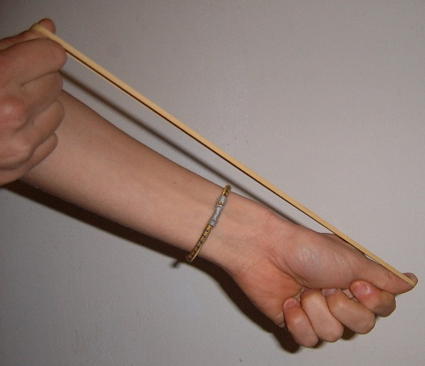
Daily Review
Reminder
When describing a force, you need to include: What is pushing / pulling what Any changes to the objects’ Speed Direction Shape
Describe the force at work in the picture below.
The ________ is pushing / pulling the ________. This is causing the ________ to change ________.
Vocabulary
force (noun) any push or pull that happens when two objects interact applied force (noun) a simple push or pull
Notes:
45 s → share → popsticks

Slide 2
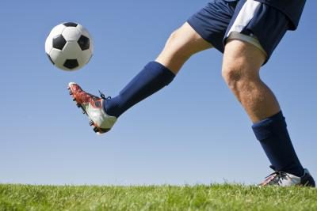
Daily Review
Reminder
When describing a force, you need to include: What is pushing / pulling what Any changes to the objects’ Speed Direction Shape
Describe the force at work in the picture below.
The ________ is pushing / pulling the ________. This is causing the ________ to change ________.
Vocabulary
force (noun) any push or pull that happens when two objects interact applied force (noun) a simple push or pull
Notes:
45 s → share → popsticks

Slide 3
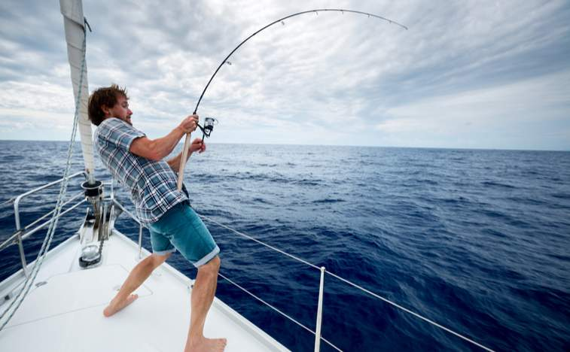
Daily Review
Reminder
When describing a force, you need to include: What is pushing / pulling what Any changes to the objects’ Speed Direction Shape
Describe the force at work in the picture below.
The ________ is pushing / pulling the ________. This is causing the ________ to change ________.
Vocabulary
force (noun) any push or pull that happens when two objects interact applied force (noun) a simple push or pull
Notes:
45 s → share → popsticks

Slide 4
Daily Review
Adding and Subtracting Forces
If two forces are going in the same direction, they are added together.
If two forces are going in opposite directions, they are subtracted.
State the net force and the direction of the force for the examples below.
5 N
3 N
3 N
1 N
1 N
4 N

Slide 5

Daily Review
Describing and Drawing Forces
When describing forces, you need to:
Draw a diagram with labelled force arrows.
Do the maths
Add the forces going in the same direction
Subtract the forces going in opposite directions
Describe the net force
Balanced (there is no net force)
Unbalanced (state the net force and its direction)
Two dogs, Rex and Duke, are fighting over a bone. Rex is pulling with 5 N and Duke is pulling with 3 N.
1.
2.
3.
5 – 3 = 2
The net force is 2 N towards Rex.
3 N
F_{Duke}
5 N
F_{Rex}

Slide 6
Daily Review
Describing and Drawing Forces
When describing forces, you need to:
Draw a diagram with labelled force arrows.
Do the maths
Add the forces going in the same direction
Subtract the forces going in opposite directions
Describe the net force
Balanced (there is no net force)
Unbalanced (state the net force and its direction)
Two people, Zoe and Joe, are pushing a box together across the floor. Zoe is pushing with 5 N and Joe is pushing with 6 N.
1.
2.
3.
5 N
F_{Zoe}
5 + 6 = 11
The net force is 11 N to the right.
6 N
F_{Joe}

Slide 7
Types of Forces: Friction Year 7 Science

Slide 8
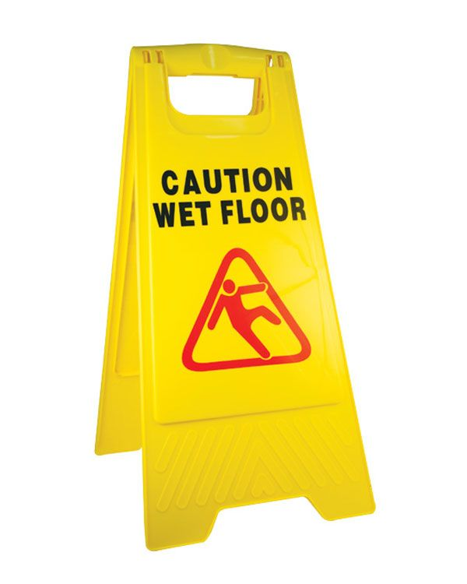
Learning Objectives
CFU
In your own words: what are we going to learn?
Describe and identify friction.
Use friction in force diagrams.
Activate Prior Knowledge
Think, pair share:
Why is it important to drive slowly in wet weather?
Why do cleaners use these signs?

Slide 9

Concept Development
CFU 1
What does friction do?
What is friction?
Friction is a force that ______ movement between two objects that are touching. It is a contact force.
The amount of friction depends on the _______ of the object being pushed and the smoothness of the surfaces.
Friction always acts in the _________ direction to movement.
CFU 2
In which direction does friction act?
CFU 3
The amount of friction depends on: The weight of the object being pushed The size of the object The colour of the surface The smoothness of the surfaces
Vocabulary
contact force a force that requires two objects to be touching
F_{push}
F_{friction}

Slide 10
Concept Development
CFU 1
In this video, between which two objects is there friction?
What is friction?
Friction doesn’t only happen between two solid objects: gases (e.g. air) and liquids (e.g. water) can create friction too.
CFU 2
In which direction does the friction act?
CFU 3
If the bullet was fired through the air, there would be: More friction Less friction Equal friction No friction How do you know?
Vocabulary
friction (noun) a force that resists movement between two objects that are touching

Slide 11
Skill Development / Guided Practice
Describing and Drawing Forces
When describing forces, you need to:
Draw a diagram with labelled force arrows.
Remember: friction will resist movement!
Do the maths
Add the forces going in the same direction
Subtract the forces going in opposite directions
Describe the net force
Balanced (there is no net force)
Unbalanced (state the net force and its direction)
Arnold is pulling a trolley across the floor. He is pulling with 5 N. There are 2 N of friction between the ground and the wheels of the trolley.
1.
2.
3.

Slide 12
Skill Development / Guided Practice
Describing and Drawing Forces
When describing forces, you need to:
Draw a diagram with labelled force arrows.
Remember: friction will resist movement!
Do the maths
Add the forces going in the same direction
Subtract the forces going in opposite directions
Describe the net force
Balanced (there is no net force)
Unbalanced (state the net force and its direction)
Arnold is pulling a trolley across the floor. He is pulling with 5 N. There are 2 N of friction between the ground and the wheels of the trolley.
1.
2.
3.
5 N
F_{Arnold}
5 - 2 = 3
The net force is 3 N towards Arnold. The forces are not balanced.
2 N
F_{Friction}
(Arrows not to scale)

Slide 13
Skill Development / Guided Practice
Describing and Drawing Forces
When describing forces, you need to:
Draw a diagram with labelled force arrows.
Remember: friction will resist movement!
Do the maths
Add the forces going in the same direction
Subtract the forces going in opposite directions
Describe the net force
Balanced (there is no net force)
Unbalanced (state the net force and its direction)
A block of ice is sliding down a hill. The Earth is pulling the block down the hill with 50 N of force. There are 3 N of friction between the ice block and the ground.
1.
2.
3.

Slide 14
Skill Development / Guided Practice
Describing and Drawing Forces
When describing forces, you need to:
Draw a diagram with labelled force arrows.
Remember: friction will resist movement!
Do the maths
Add the forces going in the same direction
Subtract the forces going in opposite directions
Describe the net force
Balanced (there is no net force)
Unbalanced (state the net force and its direction)
A block of ice is sliding down a hill. The Earth is pulling the block down the hill with 50 N of force. There are 3 N of friction between the ice block and the ground.
F_{Friction}
3 N
1.
2.
3.
F_{Earth’s Pull}
10 N
10 - 3 = 7
The net force is 7 N down the hill. The forces are not balanced.
(Arrows not to scale)

Slide 15
Skill Development / Guided Practice
Describing and Drawing Forces
When describing forces, you need to:
Draw a diagram with labelled force arrows.
Remember: friction will resist movement!
Do the maths
Add the forces going in the same direction
Subtract the forces going in opposite directions
Describe the net force
Balanced (there is no net force)
Unbalanced (state the net force and its direction)
Paul and Pamela are pushing a box together. Paul is pushing with 5 N and Pamela is pushing with 4 N.
There are 9 N of friction between the ground and the box.
1.
2.
3.

Slide 16
Skill Development / Guided Practice
Describing and Drawing Forces
When describing forces, you need to:
Draw a diagram with labelled force arrows.
Remember: friction will resist movement!
Do the maths
Add the forces going in the same direction
Subtract the forces going in opposite directions
Describe the net force
Balanced (there is no net force)
Unbalanced (state the net force and its direction)
Paul and Pamela are pushing a box together. Paul is pushing with 5 N and Pamela is pushing with 4 N.
There are 9 N of friction between the ground and the box.
1.
5 N
F_{Paul}
2.
3.
9 N
F_{Friction}
5 + 4 = 9
9 – 9 = 0
The net force is 0 N. The forces are balanced.
4 N
F_{Pamela}
(Arrows not to scale)

Slide 17
Skill Development / Guided Practice
Describing and Drawing Forces
When describing forces, you need to:
Draw a diagram with labelled force arrows.
Remember: friction will resist movement!
Do the maths
Add the forces going in the same direction
Subtract the forces going in opposite directions
Describe the net force
Balanced (there is no net force)
Unbalanced (state the net force and its direction)
Yaz and Zach are pulling a sled up a hill. Yaz is pulling with 3 N and Zach is pulling with 2 N. The Earth is pulling the sled down the hill with 5 N of force. There is 1 N of friction between the sled and the ground.
1.
2.
3.

Slide 18
Skill Development / Guided Practice
Describing and Drawing Forces
When describing forces, you need to:
Draw a diagram with labelled force arrows.
Remember: friction will resist movement!
Do the maths
Add the forces going in the same direction
Subtract the forces going in opposite directions
Describe the net force
Balanced (there is no net force)
Unbalanced (state the net force and its direction)
Yaz and Zach are pulling a sled up a hill. Yaz is pulling with 3 N and Zach is pulling with 2 N. The Earth is pulling the sled down the hill with 5 N of force. There is 1 N of friction between the sled and the ground.
F_{Zack}
2 N
1.
2.
3.
F_{Yaz}
3 N
3 + 2 = 5
5 – 5 = 0
The net force is 0 N. The forces are balanced.
F_{Friction}
5 N
(Arrows not to scale)

Slide 19

Relevance
Knowing about forces helps you to understand the world around you.
Friction is important to all sorts of people: engineers, car mechanics, athletes, fashion designers, astronauts…

Slide 20
Skill Closure
Fill in the blanks: Friction is a force that ________ movement between two objects that are ________. It is a ________ force.
Name the two objects that there is friction between in each of these situations:
Holding a pen
Walking into the wind
A car braking suddenly (hint: there are two correct answers!)
A cyclist is riding on a windy day. His pedalling is producing 4 N of force. There are 2 N of friction between him and the air, and 1 N of friction between his wheels and the ground. Using a force diagram, calculate the net force acting on the cyclist.
Reminder
Draw a diagram with labelled force arrows. Do the maths Describe the net force

Slide 21
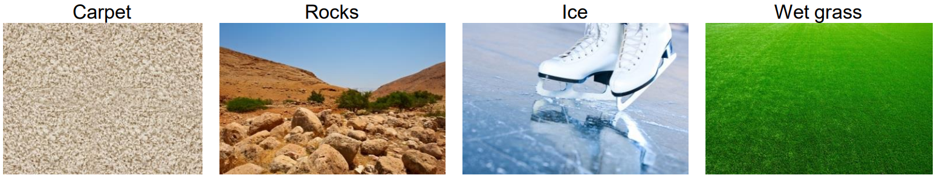
Independent Practice
Rank the following surfaces from 1 (least friction) to 4 (most friction).
Describe one situation in which friction is helpful and one situation in which friction is unhelpful.
A girl is going down a slide. The Earth is pulling her down the slide with 8 N of force. There are 1 N of friction between her and the slide, and 4 N of friction between her body and the air. Using a force diagram, calculate the net force acting on the girl.
Reminder
Draw a diagram with labelled force arrows. Do the maths Describe the net force

